Slide 1



Image Restoration and Reconstruction

Slide 2
Preview
Goal of image restoration
Improve an image in some predefined sense
Difference with image enhancement ?
Features
Image restoration v.s image enhancement
Objective process v.s. subjective process
A prior knowledge v.s heuristic process
A prior knowledge of the degradation phenomenon is considered
Modeling the degradation and apply the inverse process to recover the original image

Slide 3
Preview (cont.)
Target
Degraded digital image
Sensor, digitizer, display degradations are less considered
Spatial domain approach
Frequency domain approach

Slide 4
Outline
■
A model of the image degradation / restoration process
Noise models
Restoration in the presence of noise only – spatial filtering
■
■

Slide 5
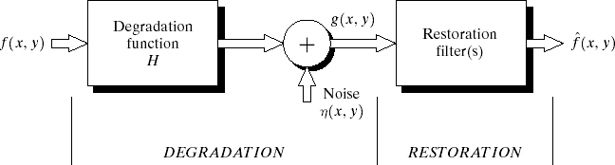
degradation/restoration process
g(x,y)=f(x,y)*h(x,y)+(x,y)
G(u,v)=F(u,v)H(u,v)+N(u,v)

Slide 6
Noise models
Source of noise
Image acquisition (digitization)
Image transmission
Spatial properties of noise
Statistical behavior of the gray-level values of pixels
Noise parameters, correlation with the image
Frequency properties of noise
Fourier spectrum
Ex. white noise (a constant Fourier spectrum)

Slide 7
Noise probability density functions
Noises are taken as random variables
Random variables
Probability density function (PDF)

Slide 8



Gaussian noise
Math. tractability in spatial and frequency domain
Electronic circuit noise and sensor
noise
1
p( z )= _{√2 π σ} e
−( z−μ )² /2 σ²
mean
variance
∞
∫ p( z)dz=1
Note:
−∞

Slide 9
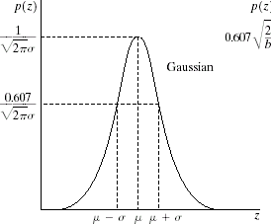
Gaussian noise (PDF)
70% in [(μ- σ), (μ+ σ)] 95% in [(μ-2 σ), (μ+σ)]

Slide 10
Uniform noise
Less practical, used for random number
generator
{ }
1
if a≤ z≤b
otherwise
p( z )= b−a
0
_{μ=} a+b
Mean:
2
( b−a )²
2
σ =₁₂
Variance:

Slide 11
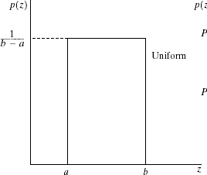
Uniform PDF

Slide 12
Impulse (salt-and-pepper) no sie
■
Quick transients, such as faulty switching during imaging
{ }
P for z=a
for z=b
a
p( z )= P_{b}
0 otherwise
I f either P_{a} or P_{b} is zero, it is called unipolar.
Otherwise, it is called bipoloar.
In practical, impulses are usually stronger than image signals. Ex., a=0(black) and b=255(white) in 8-bit ima

Slide 13
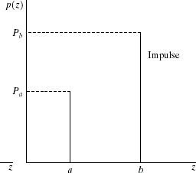
Impulse (salt-and-pepper) noise PDF

Slide 14
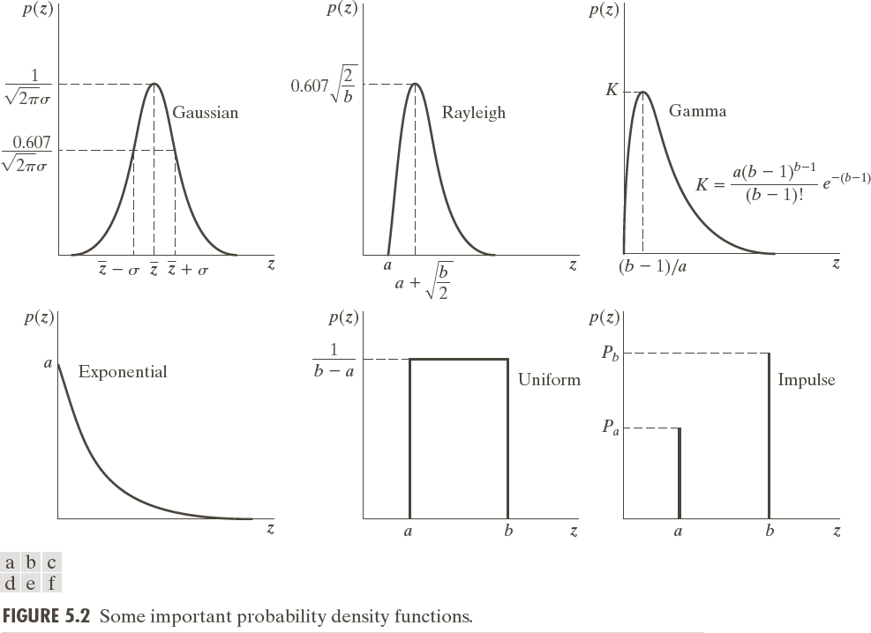
PDFs of some important noise models

Slide 15

Test for noise behavior
Test pattern
Its histogram:
0
255

Slide 16
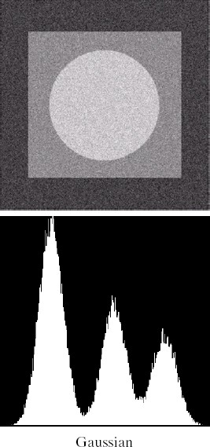
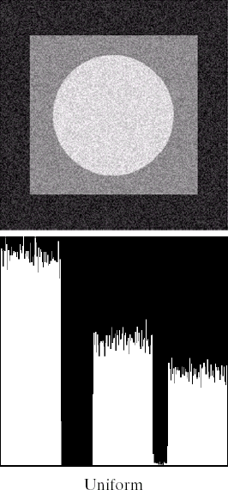
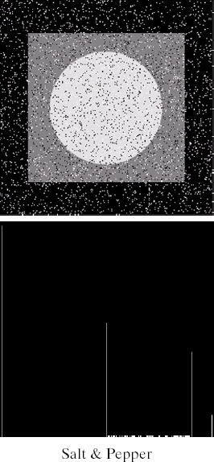

Slide 17
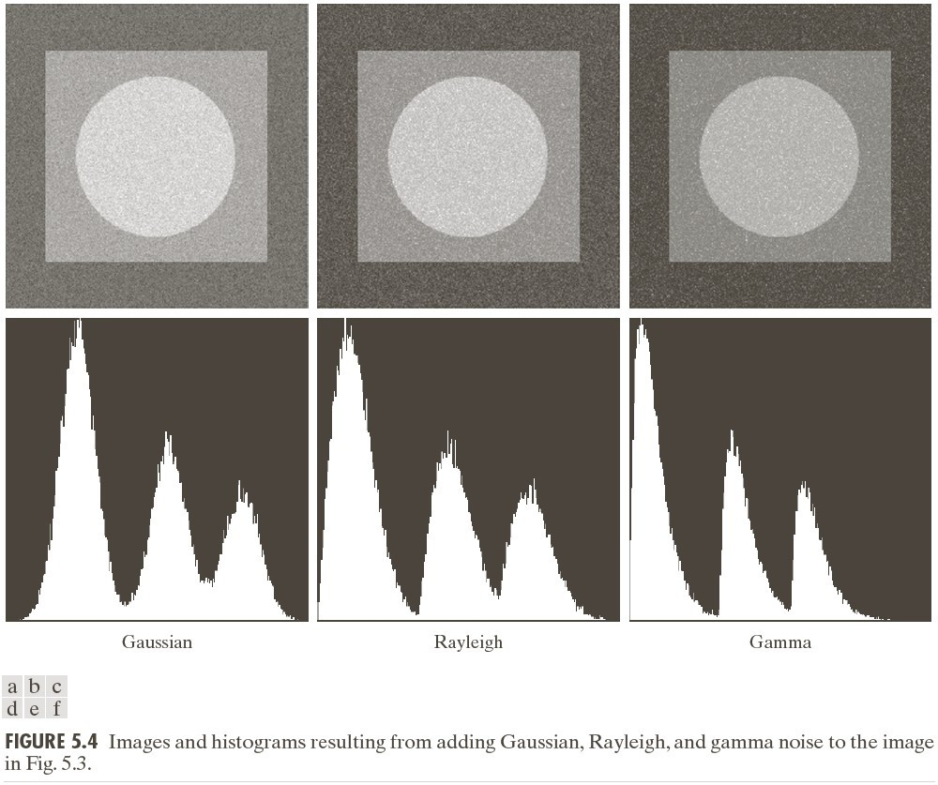
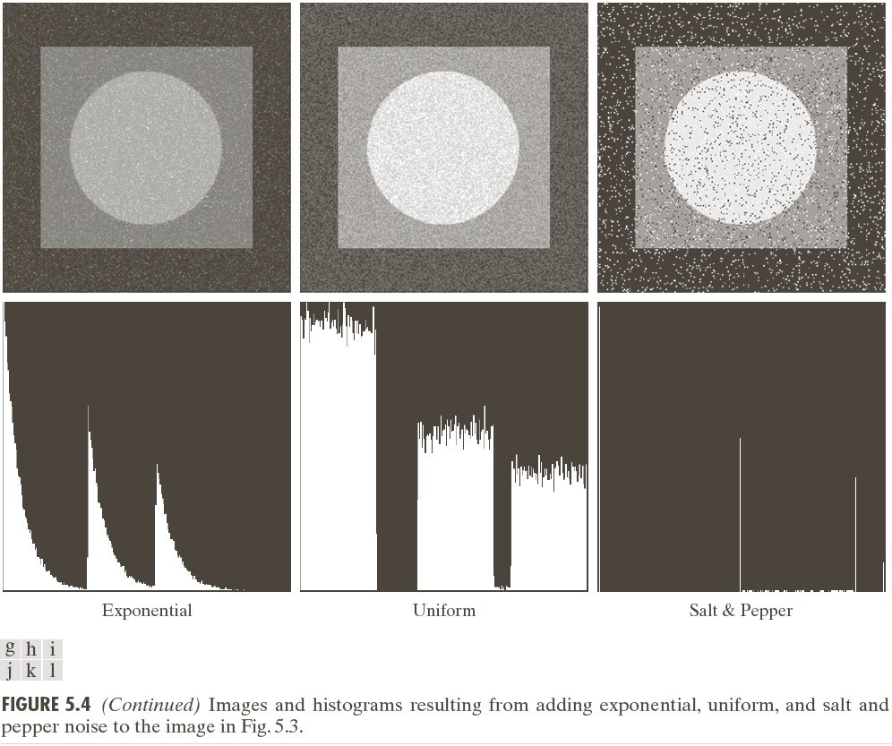

Slide 18
Periodic noise
Arise from electrical or electromechanical interference during image acquisition
Spatial dependence
Observed in the frequency domain

Slide 19
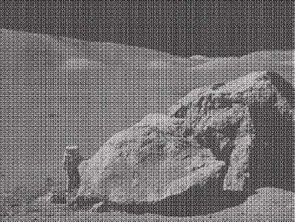
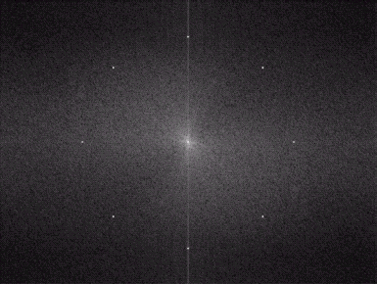
Sinusoidal noise: Complex conjugate pair in frequency domain

Slide 20
Estimation of noise parameters
Periodic noise
Observe the frequency spectrum
Random noise with unknown PDFs
Case 1: imaging system is available
Capture images of “ flat” environment
Case 2: noisy images available
Take a strip from constant area Draw the histogram and observe it Measure the mean and variance
■
■

Slide 21
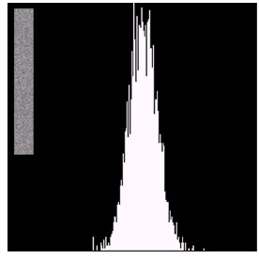
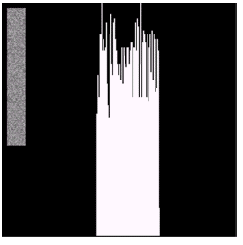
Observe the histogram
Gaussian
uniform

Slide 22
Measure the mean and variance
Histogram is an estimate of PDF
μ= ∑ z_{i} p( z_{i} )
z_{i} ∈S
2
∑
2
σ =
( z −μ ) p( z )
i i
z_{i} ∈S
Gaussian: μ, σ
Uniform: a, b

Slide 23
Outline
■
A model of the image degradation / restoration process
Noise models
Restoration in the presence of noise only – spatial filtering
Periodic noise reduction by frequency domain filtering
Linear, position-invariant degradations Estimating the degradation function Inverse filtering
■
■
■
■
■
■

Slide 24
Additive noise only
g(x,y)=f(x,y)+(x,y)
G(u,v)=F(u,v)+N(u,v)

Slide 25
Spatial filters for de- noising additive noise
Skills similar to image enhancement
Mean filters
Order-statistics filters
Adaptive filters

Slide 26
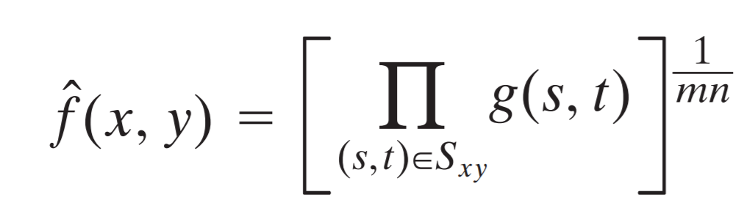
Mean filters
Arithmetic mean
∑
f^ ( x,y )= ¹
g( s,t )
Window centered at (x,y)
^{mn} ( s,t )∈ S
xy
Geometric mean

Slide 27
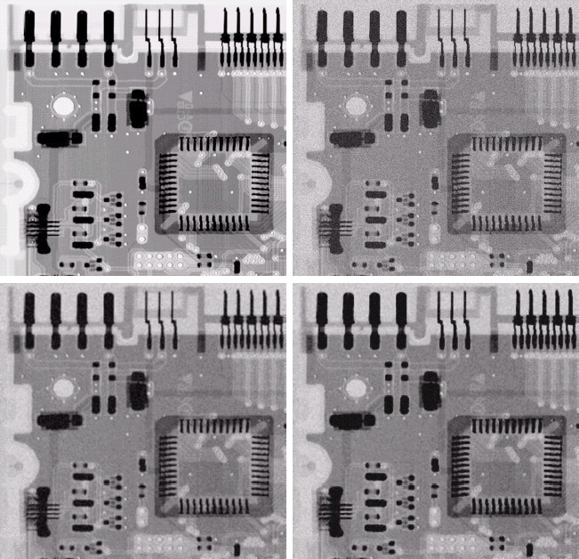
original
Noisy
Gaussian μ=0
σ =2
Arith. mean
Geometri mean

Slide 28
Mean filters (cont.)
Harmonic mean filter
f^ ( x,y )= ^{mn}
∑
1
g ( s,t )
( s,t )∈S
xy
Contra-harmonic mean filter
∑
g( s,t )^{Q+ 1}
_{f^ ( x,y )=}( s,t )∈S_{xy}
∑
( s,t )∈S_{xy}
g ( s,t )^{Q}
Q=-1, harmonic
Q=0, airth. mean
Q=+, ?

Slide 29
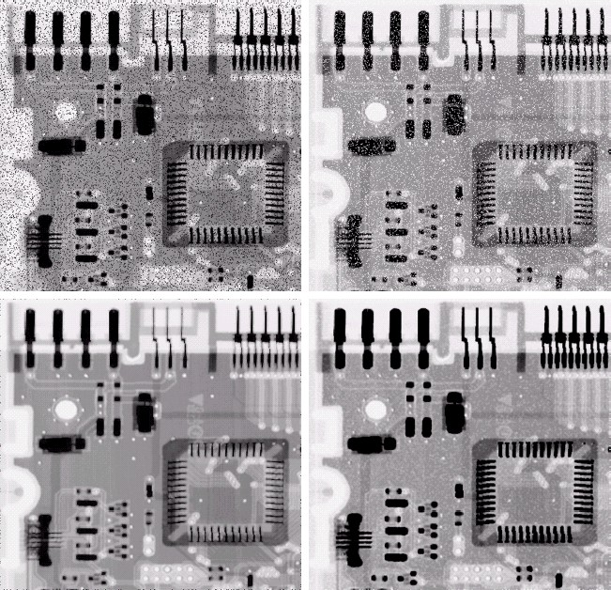
Pepper
Salt Noise
Noise
Contra-
Contra-
harmonic
harmonic
Q=1.5
Q=-1.5

Slide 30
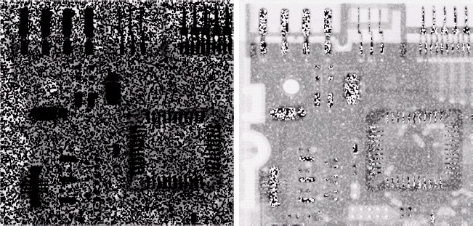
Wrong sign in contra-harmonic filtering
Q=-1.5
Q=1.5

Slide 31
Order-statistics filters
Based on the ordering(ranking) of pixels
Suitable for unipolar or bipolar noise (salt and pepper noise)
Median filters
Max/min filters
Midpoint filters
Alpha-trimmed mean filters

Slide 32
{ median g ( s,t ) }
Order-statistics filters
Median filter
Max/min filters
{ max g ( s,t ) }
{ min g ( s,t ) }

Slide 33
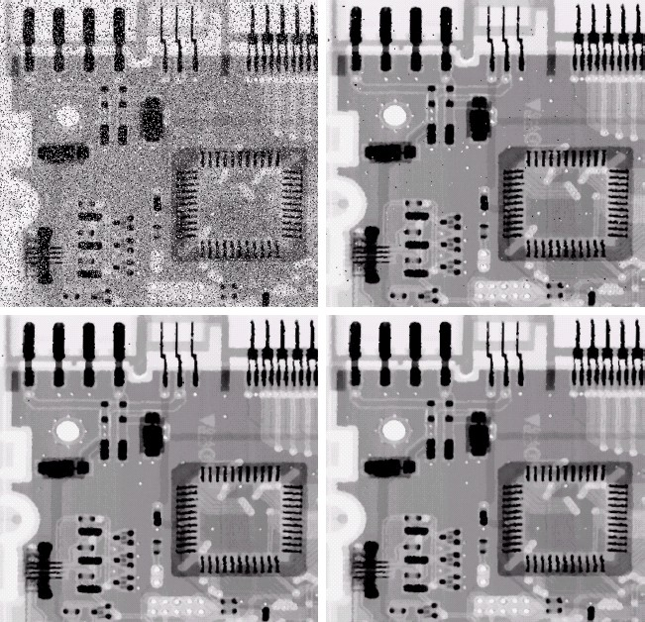
bipolar Noise P_{a} = 0.1
P_{b} = 0.1
3x3 Median
Filter Pass 1
3x3 Median Filter Pass 2
3x3 Median
Filter Pass 3

Slide 34
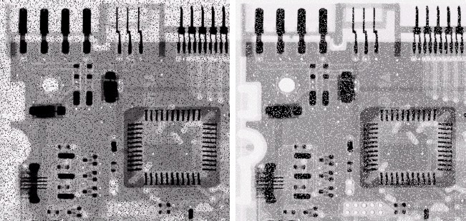
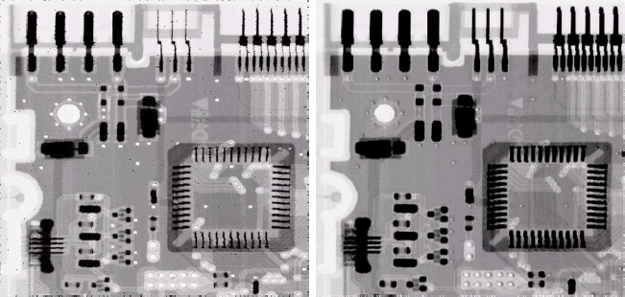
Salt noise
Pepper
noise
Max
Min filter
filter

Slide 35
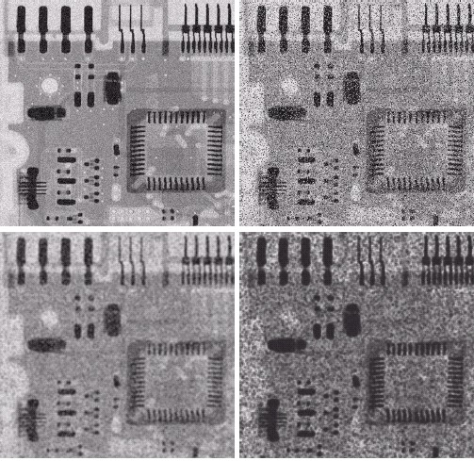
Uniform noise
μ=0 ơ²=800
Left + Bipolar Noise P_{a} = 0.1
P_{b} = 0.1
5x5 Arith. Mean
filter
5x5 Geometric mean

Slide 36
Adaptive filters
Adapted to the behavior based on the stati stical characteristics of the image inside th e filter region S_{xy}
Improved performance v.s increased compl exity
Example: Adaptive local noise reduction filt er

Slide 37
Adaptive local noise reduction filter
Simplest statistical measurement
Mean and variance
Known parameters on local region S_{xy}
g(x,y): noisy image pixel value
σ ²: noise variance (assume known a prior)
m_{L} : local mean
σ _{L} : local variance

Slide 38
Adaptive local noise reduction filter (cont.)
Analysis: we want to do
If σ ² is zero, return g(x,y)
If σ _{L}> σ, return value close to g(x,y)
If σ _{L}= σ, return the arithmetic mean m_{L}
Formula
_{σ}2
^
η
[ ]
f ( x,y ) =g( x,y )−
g( x,y )−m
_{σ} 2
L
L

Slide 39
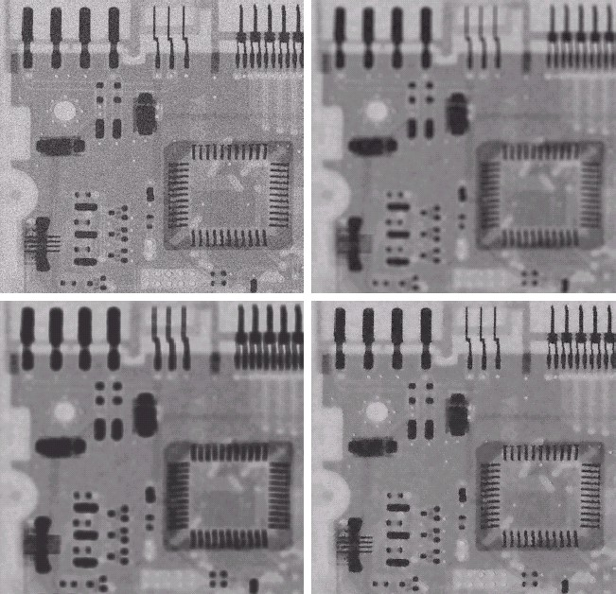
Gaussian
Arith. mean 7x7
oise
μ=0
ơ²=1000
Geometric mean
x7
adaptive

Slide 40
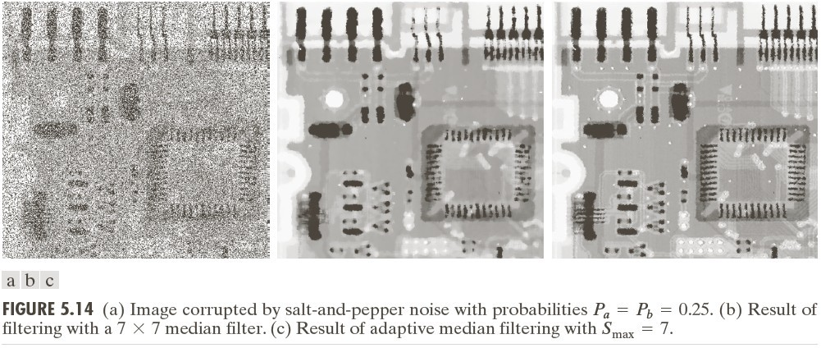
Adaptive Median Filter

